Slide 1
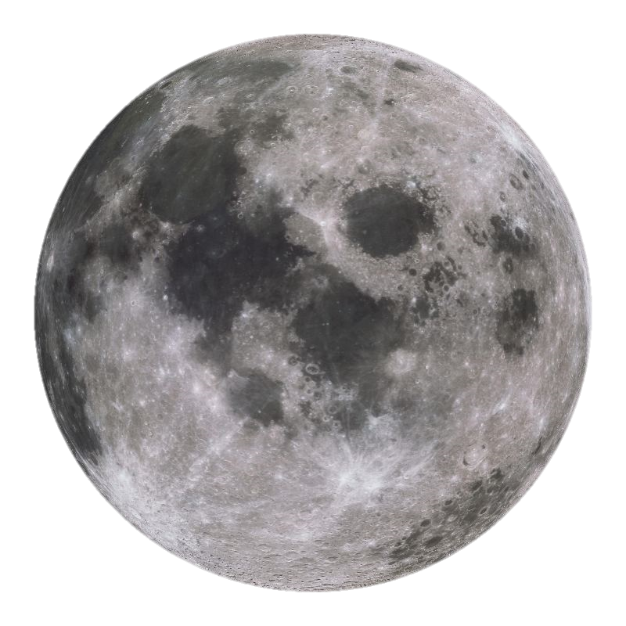
Dark Nights
Notes:
After Dark Nights comes on screen wait for moon to rise before you continue

Slide 2
HALLOWEEN
TRICK OR TREAT!
HALLOWEE
Notes:
Questions to ask: Date of Halloween? What is the meaning of Halloween?

Slide 3
Organised parties with family and friends are the safest way to enjoy Halloween
Your Safety on Halloween
If you are out trick or treating with younger brothers & sisters please stay together and make sure you tell your parents where you are going
Only knock the doors of people you know are taking part in Halloween (ie pumpkin on display)
Make sure you are back at home at the time agreed with your parents

Slide 4
Window & Door Signs
Notes:
Statements: If you see any of these signs in windows or doors DO NOT KNOCK !! These have been handed out by neighbourhood policing teams to vulnerable adults and people that don’t want to take part, they may have very young children or someone within the home may be ill.

Slide 5
Not everyone in your community enjoys Halloween & Bonfire Night
Your Pets !
Who else might be frightened ?
Notes:
Statement: Keep all pets indoors after dark. Pets get very distressed during this time of year

Slide 6
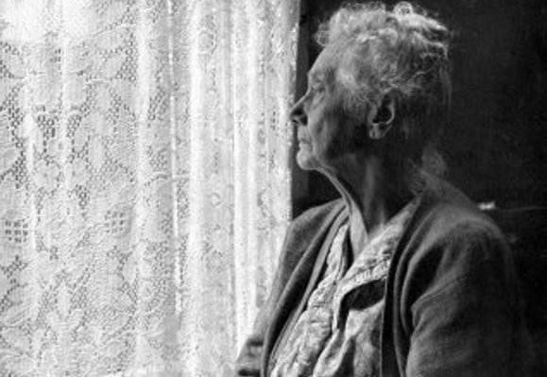
This could be someone you know !
The Elderly & Vulnerable
Notes:
Note: As soon as the music starts you will have about 60 secs to click through the next slide. Leave this slide on the screen for about 10 secs.

Slide 7
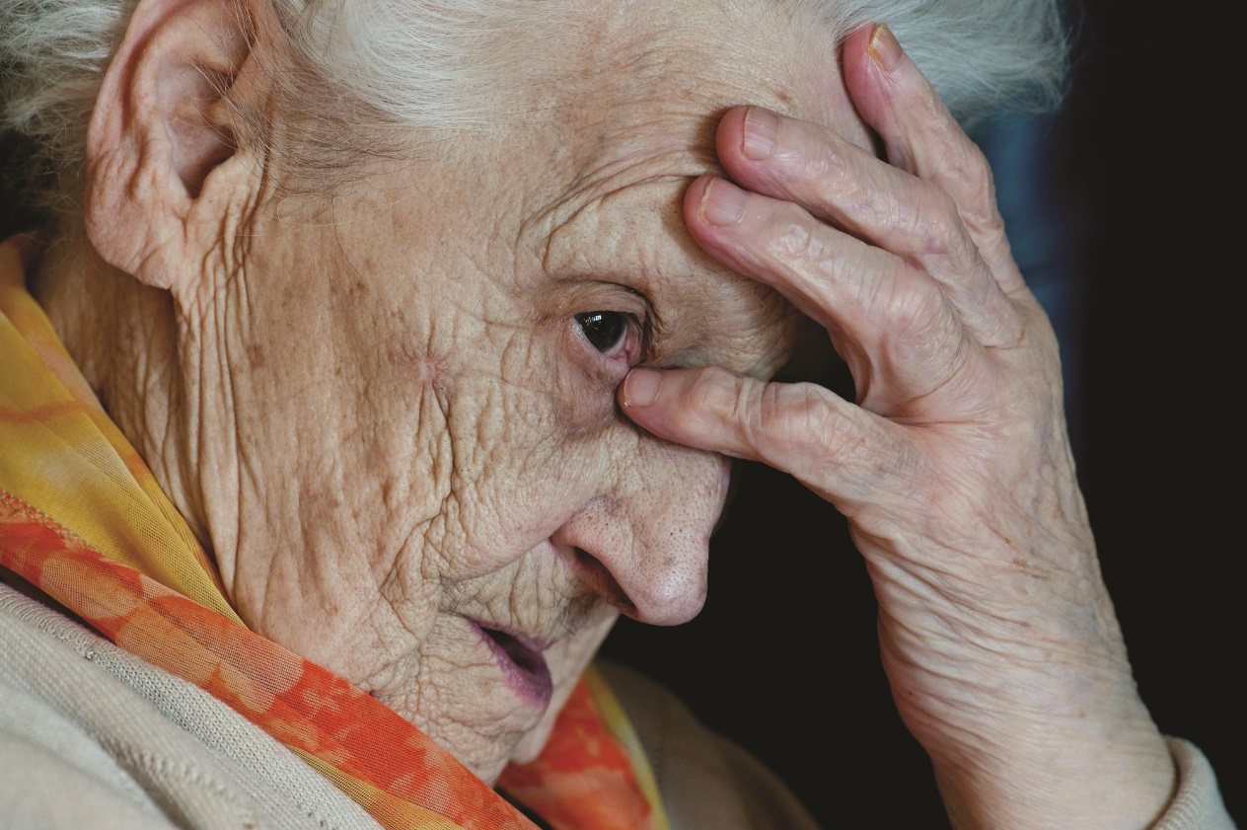
Are they picking on me because I’m old and live alone?
I do wish they wouldn’t knock on my door… I’m frightened
Don’t they care how it makes me feel?
I’m SO scared !!
I can’t take it any more !
Every year is the same! It’s the time of the year I dread the most….
If I turn all my lights and TV off and sit in the dark, they won’t know I’m in and might leave me alone !!!
Notes:
Notes: With each click thought bubbles come up one at a time. Allow approx. 5/6 secs between each bubble (bubbles go off screen displaying one at a time at each click). The last thought bubble is “I can’t take it any more” after the next click the old lady will still be on the screen. Another click and she will fade away. (The music will fade after approx. 60 secs)
When the ‘old ladies’ picture fades after the last click make this a personal reflection to the students such as that could be your Grandmother or neighbour etc

Slide 8
Bonfire Night
Notes:
Question: What date is Bonfire Night? What is the meaning behind bonfire night?

Slide 9
Firework Code
Never go near fireworks without an adult
Fireworks should be kept in a box or tin and used one at a time
Keep a bucket of water close by
Do NOT go near a firework even if it looks like it has gone out
Keep pets indoors

Slide 10
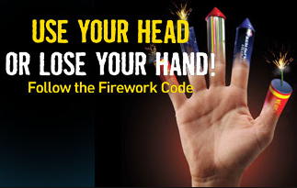
Firework Code
Notes:
Note: Talk about safe use of fireworks

Slide 11
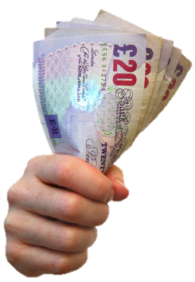
Fireworks & The Law
It is illegal to possess a firework in a public place if you are under 18yrs of age
If a Police Officer or PCSO finds you with fireworks they WILL be seized, you WILL be taken home where your parents WILL receive a fine
Notes:
Statements: Emphasise that PCSO’s can seize fireworks and carrying fireworks on the way to a party is no excuse in law. There are no exceptions to having fireworks in a public place under 18years.

Slide 12
Bonfire Night Safety
Pre-arranged Events…
Safer
Bigger and better fireworks
Somewhere to go with your friends
Local events
Notes:
Note: List of your local events times and entry fees on final point when you get to the local events point

Slide 13
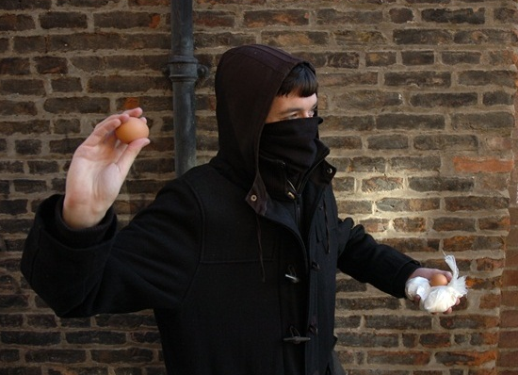
Your responsibilities
DON’T get involved in Anti Social Behaviour
Throwing eggs !
Knock door run !
Wearing scary masks & running around in gangs
Notes:
Notes: Discuss possible offences and the impact of getting a criminal record. Using local examples of previous offences.
Egg throwing: criminal damage, assault endangering lives whilst driving
Knock Door Run: Harassment if repeated
Gangs in Masks: public order offences.

Slide 14
Have Fun &
Stay Safe !
Notes:
The next slide is the last one which ask if there are any questions……

Slide 15
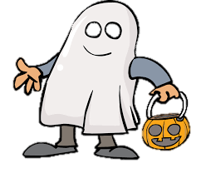
Any Questions?

